Slide 1

Developing a Convolutional Neural Network Model to detect cancerous and non-cancerous images
Student Name: Piyush Kumar
BITS ID: 2021B1A40815P
Email: f20210815@pilani.bits-pilani.ac.in

Slide 2
Objectives
Objective 1: Build a CNN model to detect Lung Cancer images
Objective 2: Build a Generative Adversarial Networks (GAN)/Hybrid CNNs/Residual Networks based model to detect Skin or Breast Cancer.
Objective 3: Improve the detection based metrics of the above-built model.
Objective 4: Draft and publish a research paper based on the results found.

Slide 3
Work Plan
Objective | Activities
1. CNN based model to detect Lung Cancer. | Finding a research paper based on Lung Cancer detection using CNN. Developing a CNN based model to detect Lung Cancer.
2. GAN/Hybrid CNNs/ResNet based model to detect Skin or Breast Cancer. | Finding a research paper based on Skin or Breast Cancer detection using GAN/Hybrid CNNs/ ResNet based models. Developing a similar model to detect Skin or Breast Cancer.
3. Improving detection based metrics. | Learning Open CV and Image Processing techniques to improve the metrics.
4. Publishing the research paper. | Comparing all the metrics of different models and sharing the results.

Slide 4
Activity-wise Timeline
Activities | Expected Outcome | Tentative Date of completion
1.1. Finding a research paper based on lung cancer detection | Learning about contemporary techniques used in Lung Cancer detection and previous work done in this field. | 08.08.24
2. Developing a CNN based model to detect Lung Cancer. | Introduction to vast coding structure of CNN models and dataset analysis and implementation of a CNN model. | 20.08.24
3. Finding a research paper based on Skin or Breast Cancer detection using GAN/Hybrid CNNs/ ResNet based models. | Generative Adversarial Networks (GAN), Hybrid CNNs, Residual Networks based models and comparison of their individual results. | 30.08.24
4. Developing a similar model to detect Skin or Breast Cancer. | Based on the comparison of metrics of GAN, Hybrid CNNs and Residual Networks, the best algorithm will be selected to form this Cancer Detection model. | 21.09.24
5. Learning Open CV and Image Processing techniques to improve the metrics. | After learning Open CV and Image Processing, segregation of certain techniques will be done in order to improve performance of the model. | 20.10.24
6. Publishing the research paper. | Based on the comparison of metrics between the different models used, and after enhancing the metrics, the results will be shared in the research paper. | 30.11.24

Slide 5
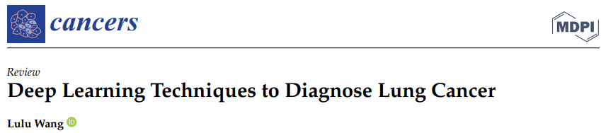
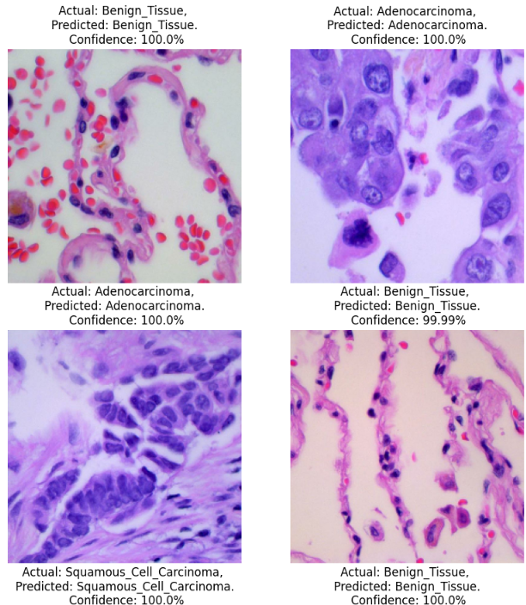
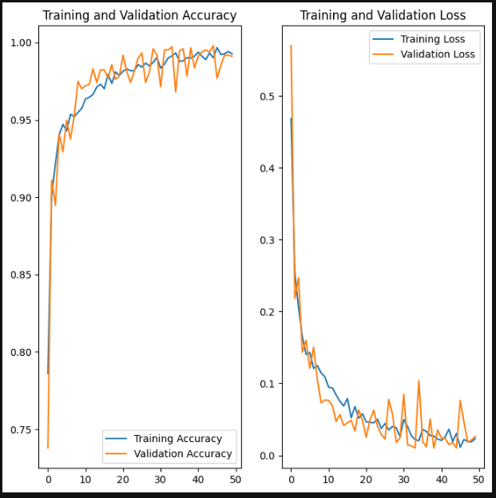
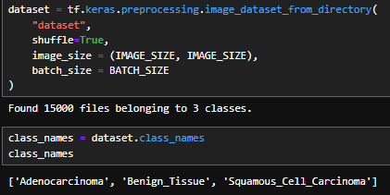
Current Progress
Read Research Paper based on Lung Cancer Detection using CNN
Built a CNN model to detect Lung Cancer images.
Dataset of 15,000 images
Final Accuracy = 99.274516%
Testing the Model

Slide 6
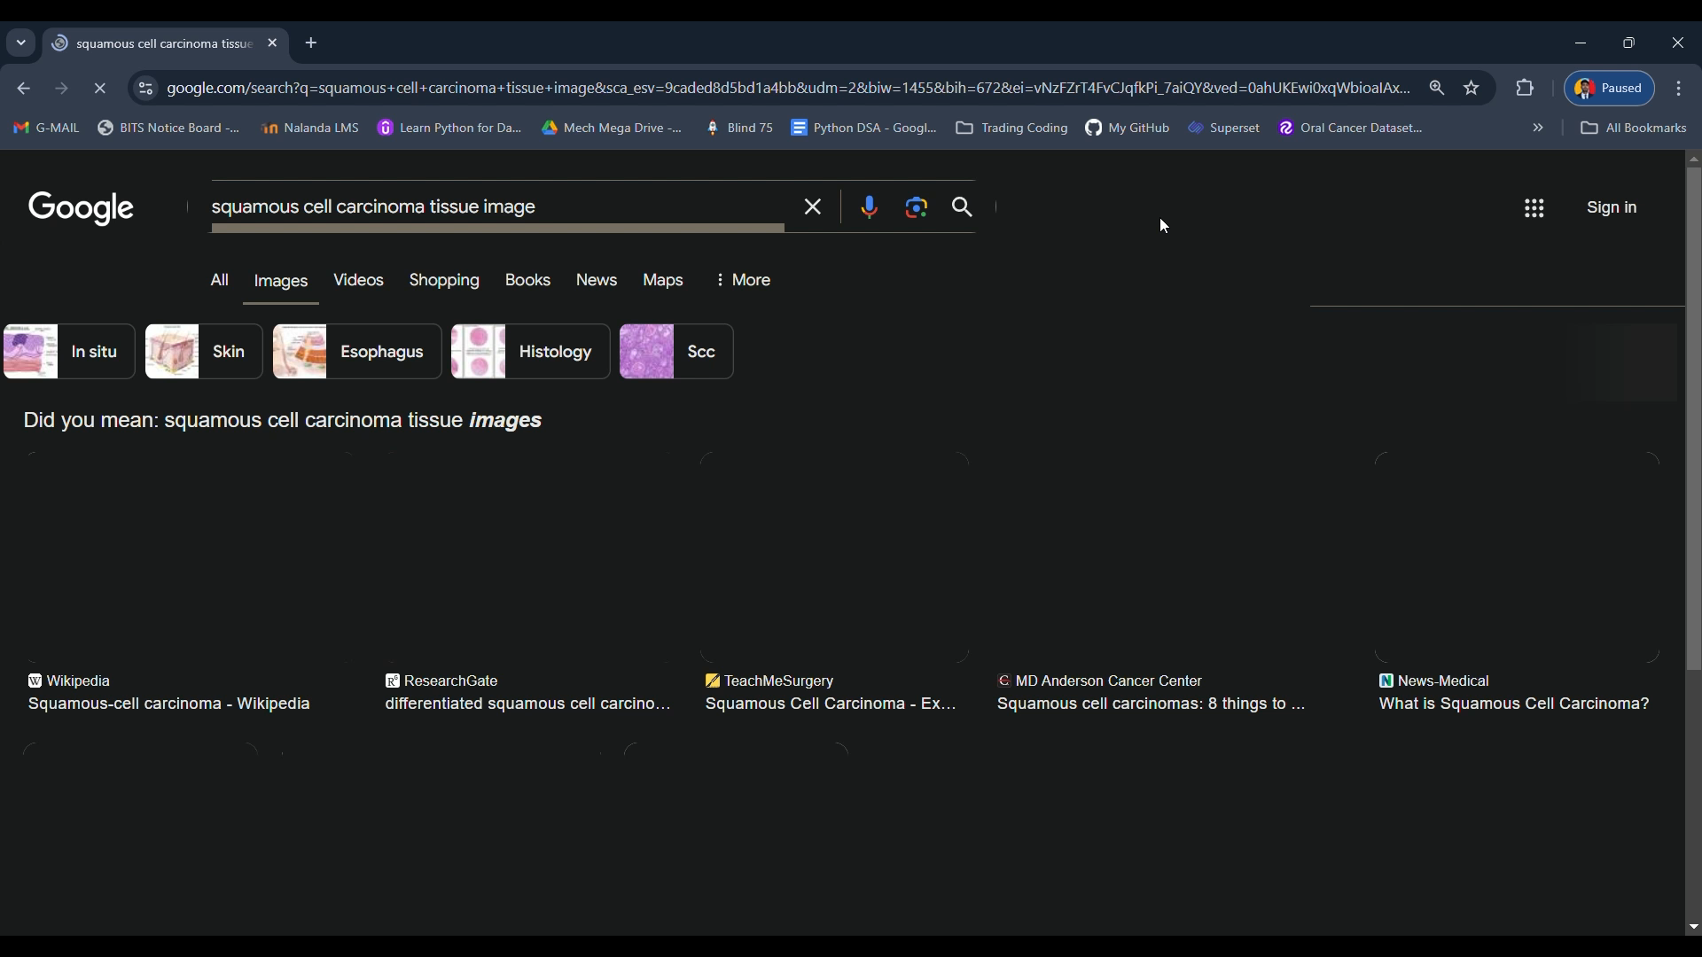

Slide 7
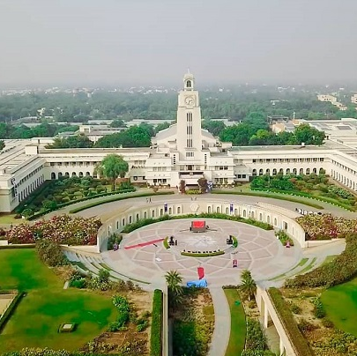
Thank you

